Slide 1
This Space Left Intentionally Blank

Slide 2




Quantum Error Correcting Subsystem Codes
and Fault-Tolerant Quantum Computing
Dave Bacon
Department of Computer Science & Engineering
University of Washington, Seattle, WA
Funded by:

Slide 3
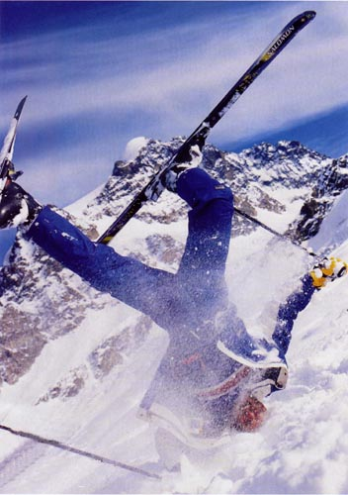
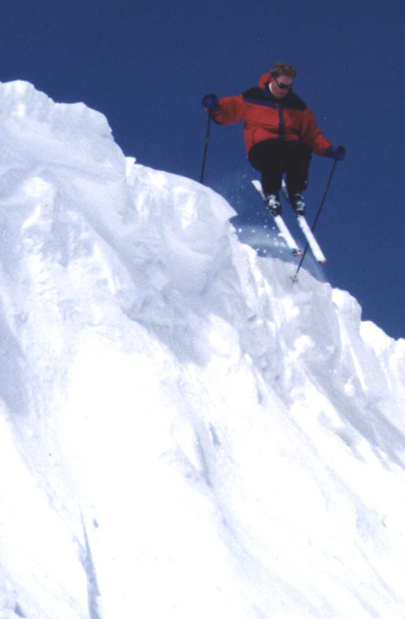
Paradise?

Slide 4




Problem Child
decoherence:
Environment
System
open quantum systems can become
entangled with their environment
coherent superposition
incoherent sum
imprecise and faulty control:
unitary gates, preparation, measurements
System
Control

Slide 5

My Mortal Enemy

Slide 6

Problem Solution
QC
errosol
“decoherence”
“imprecision”
Threshold Theorem for Fault-Tolerant Quantum Computation
[Aharonov, Ben-Or, Knill, LaFlamme, Zurek, Shor, Gottesman, Preskill]
If decoherence is weak enough and control is precise enough,
then a quantum computation to a desired accuracy can be
carried out with an overhead polynomial in the log of the accuracy.

Slide 7
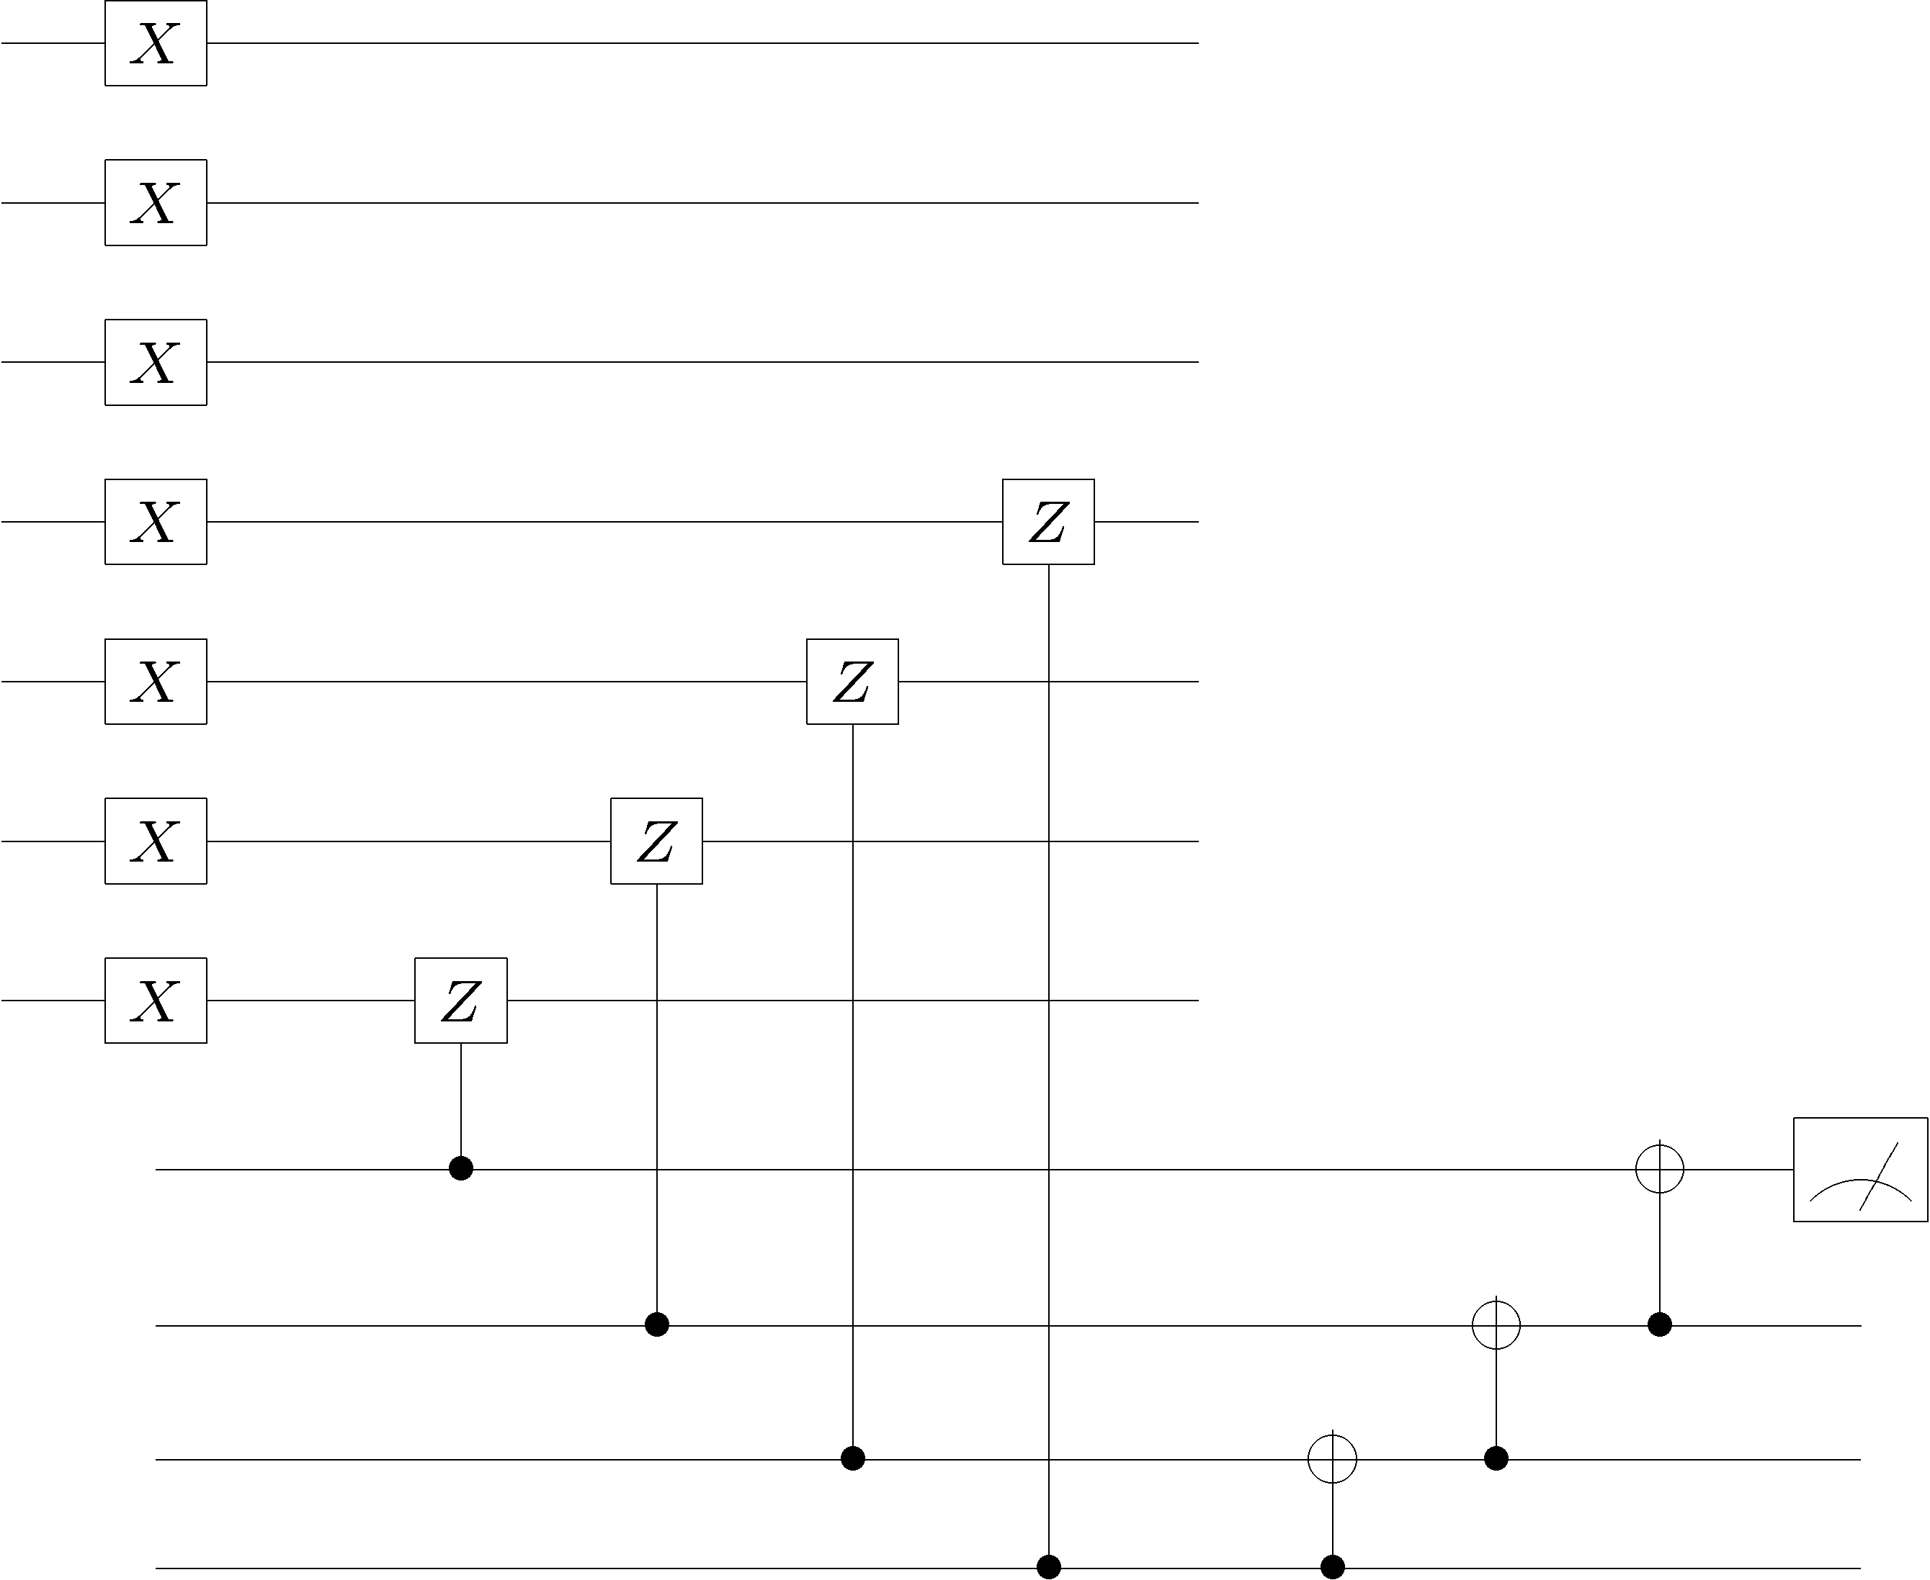
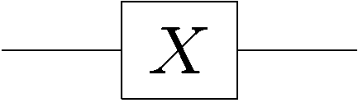
Sketch: How It Works
To make robust elements, information is encoded into a quantum
error correcting codes of significant size and fault-tolerant methods
are used for gates, preparation, measurement, and correction

Slide 8
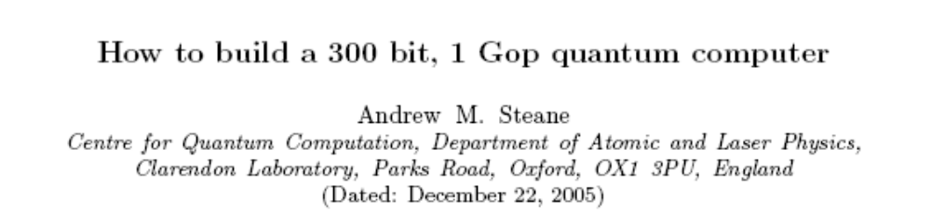
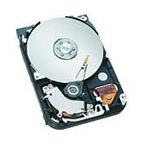
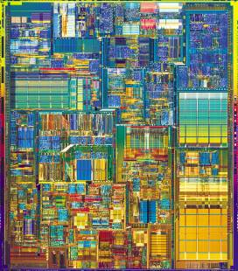
In Practice?
13000 ions, 1000 laser beams, 160000 electrodes in ion trap
The device complexity simply to engineer robust qubits is severe
“A quantum computer will spend most of its time doing error correction.”
CONTRAST:
Is there a better way? Can we mimic classical computers?

Slide 9
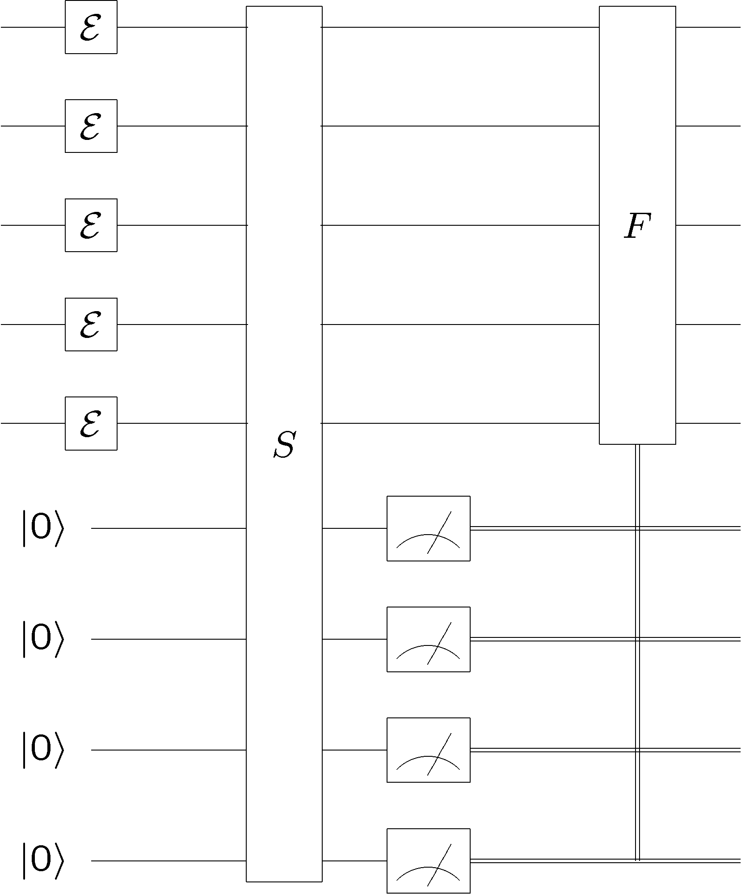
Quantum Error Correction
error
diagnose
fix
encoded
quantum
information
encoded
quantum
information
“cold”
ancilla
qubits
“hot”
ancilla
qubits
Quantum error correction is essentially (sophisticated) cooling

Slide 10
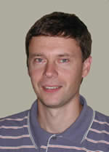
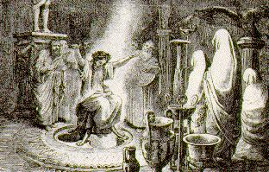


The Quantum Hard Drive?
Kitaev
Do there exist (or can we engineer) quantum systems whose
physics guarantees fault-tolerant quantum computation?

Slide 11
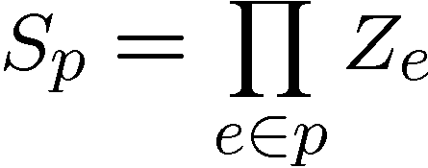
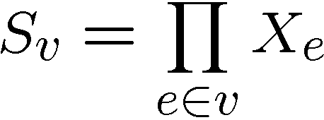




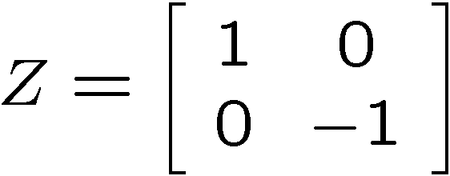
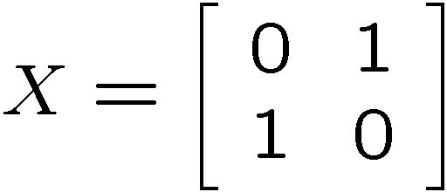
Kitaev’s Model
plaque operators:
qubits on links
vertex operators:
vertex and plaque operators
all commute with each other

Slide 12
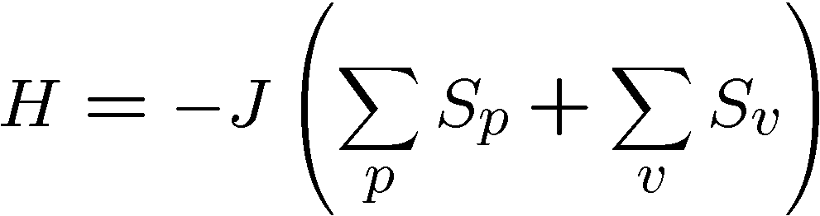






Kitaev’s Model, Continued
Hamiltonian
plaque operators:
vertex operators:
ground state has all

Slide 13
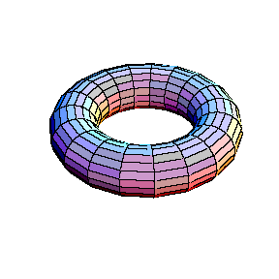
Topology of Operators
plaque operators:
products of vertex operators
are closed loops of Z’s which
are homologically trivial
on dual lattice, vertex operators play same rule

Slide 14

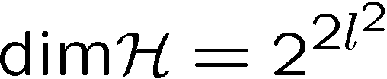

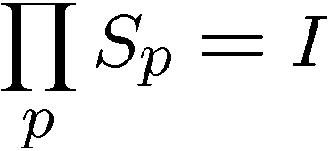
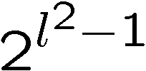

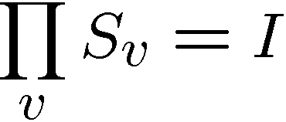

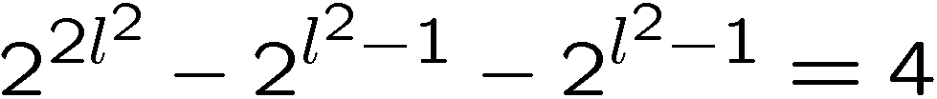
Degeneracy
Hamiltonian
plaque operators:
vertex operators:
qubits
plaque operators
values
vertex operators
values
every energy level is degenerate

Slide 15


Kitaev’s Model
plaque operators:
vertex operators:
anti-commutes with
two plaque operators
−
−
excitation is above ground state

Slide 16
Excitations
excitations particles come in pairs (particle/antiparticle)
at end of “error” chains
two types of particles, X-type (live on vertices of dual lattice)
Z-type (live on vertices of the lattice)

Slide 17



A Qubit
Moving an X or Z type particle on a homologically nontrivial
path and annihilating with it’s partner preserves the ground
states
Action on ground state must be representation of non-Abelian
group: Acts as encoded single qubit Pauli operator.

Slide 18


Anyons Anyone?
Phase:

Slide 19


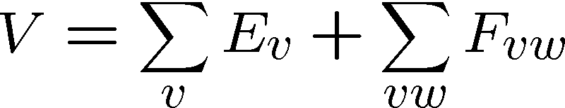
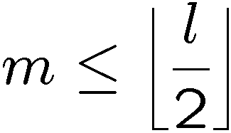
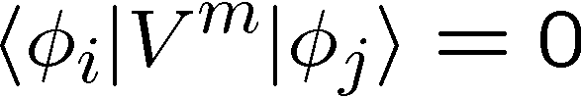
Topological Protection
Encode two qubits
into the ground state
gap
Perturbation theory:
But for

Slide 20

Topological Quantum Computing
Encode two qubits
into the ground state
gap
If we keep then quantum information encoded into ground state will be “topologically” robust to perturbation.
We can perform gates (in this example X and Z) by creating
anyon pairs and moving them around the torus.
Are these assumptions reasonable?

Slide 21
Topological Error Correction
Different mode of using Kitaev’s Model, as a component in
a fault-tolerant quantum computer, encode into ground state
1. Errors occur
2. Measure vertex and plaque operators
3. Apply recovery operator
4. If created loop is homologically trivial,
then we have restored information
encoded into ground state.
Full analysis: measurements uncertain, recovery may fail, etc.
Threshold for fault-tolerant storage of quantum information:
[Dennis, Kitaev, Landahl, Preskill 2002]
[Wang, Harrington, Preskill 2003]

Slide 22
Fault-Tolerant?
Encode two qubits
into the ground state
gap
If we keep then quantum information encoded into ground state will be “topologically” robust to perturbation.
We can perform gates (in this example X and Z) by creating
anyon pairs and moving them around the torus.
Are these assumptions reasonable?

Slide 23
Fault-Tolerant?
time

Slide 24


Three Storage Testbeds
Ferromagnetic Ising models:
one dimensional
two (and >) dimensional
Toom’s rule:
0
0
1
0
0
0
0
0
0
1
1
0
1
0
0
0
two dimensional noisy
cellular automata
0
1
0
0
0
0
0
0
0
0
1
1
1
1
1
0
0
0
0
0
1
0
1
0
1
1
1
0
0
0
0
0

Slide 25
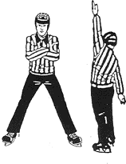

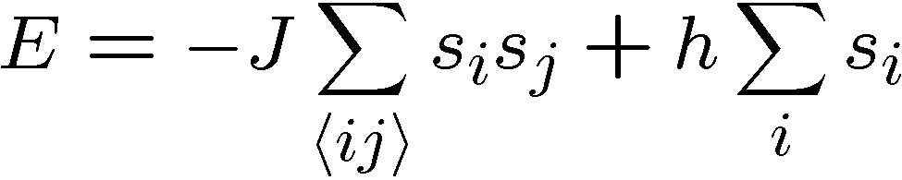


Ferromagnetic Ising Models
Ising model
spins on edges of a lattice:
energy of a configuration:
sum over neighbors
external magnetic field
for now

Slide 26

Dynamic Ising Models
Dynamic Ising model (Metropolis update)
Interaction with environment causes spin flips
Update rule:
If flipping spin would decrease energy, flip spin
If flipping spin would increase energy, flip spin with probability

Slide 27
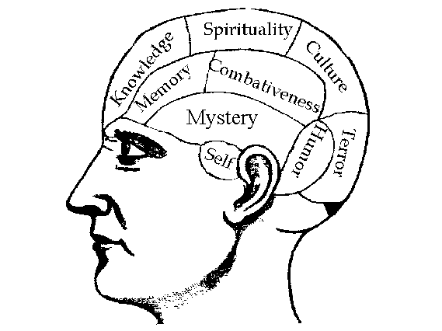


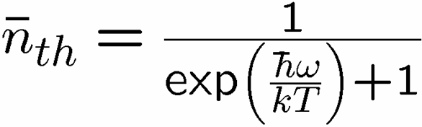

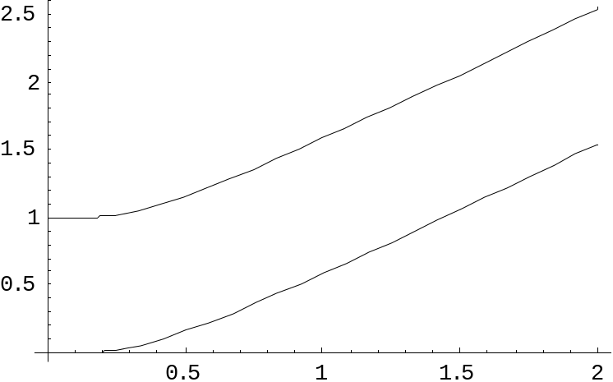
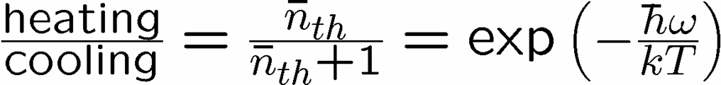


Reminder
two-level system perturbatively coupled to a thermal boson bath
“heating”
“cooling”
“non-dissipative”

Slide 28
Dynamic Ising Models
Dynamic Ising model (Metropolis update)
Interaction with environment causes spin flips
Update rule (alternate with noise):
If flipping spin would decrease energy, flip spin
If flipping spin would increase energy, flip spin with probability

Slide 29
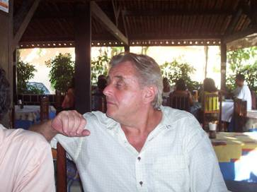
Toom’s Rule
0
0
1
0
0
0
0
0
0
1
1
0
1
0
0
0
two dimensional noisy cellular automata
0
1
0
0
0
0
0
0
0
0
1
1
1
1
1
0
0
0
0
0
1
0
1
0
1
1
1
0
0
0
0
0
Update rule:
n
n
b=majority(n,e,b)
a
e
b
e
0
0
0
0
0
0
0
0
0
0
0
0
0
0
0
0
0
1
1
0
0
1
0
0
0
0
0
0
0
0
0
0
0
1
0
0
0
1
0
0
0
1
0
0
0
0
0
0
0
0
0
0
0
0
0
0
0
0
0
0
0
0
0
0
Update rule with noise: with some probability the update fails
and a random state is assigned

Slide 30


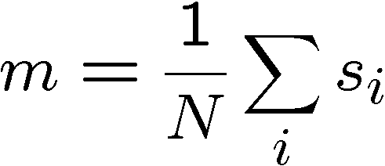
Compare and Contrast
Encode information into the system and watch what happens
0
0
0
0
0
0
0
0
0
0
0
0
0
0
0
0
0
0
0
0
0
0
0
0
0
0
0
0
0
0
0
0
0
0
0
0
0
0
0
0
0
0
0
0
0
0
0
0
Redundancy code.
Order parameter is magnetization:

Slide 31


Storage
Long time behavior (not infinite time, but effectively)
1D Ising
2D Ising
Toom’s Rule
Criticism: (1) thermodynamic limit taken
(2) what if relaxation to equilibrium takes a long time?

Slide 32
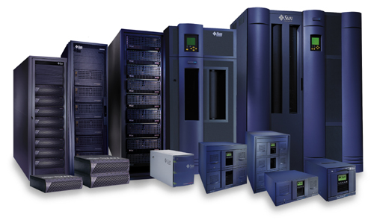


Storage
2nd attempt:
Relaxation to thermal
1D Ising
2D Ising, Toom’s Rule
Imperfect preparation

Slide 33
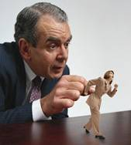




Manipulation
Flipping spins is imperfect
2D Ising
Toom’s Rule
1D Ising
1D Ising
temperature less than gap
manipulation error must be small
(i.e. NOT fault-tolerant)
2D Ising
temperature less than critical temp

Slide 34















“Self Fixing”
Excitations point-like
Energy to err is constant
Disordering entropy >> Energy
Excitations string-like
Energy to error is prop to perimeter
Energy >> Disordering entropy

Slide 35
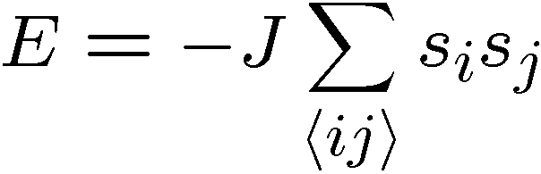

Self-Correction
Energy:
sum over neighbors
Energy is proportional to perimeter

Slide 36

Toom’s Rule Versus 2D Ising
Applied magnetic field (corresponds to a bias in noise)
2D Ising
Toom’s Rule
Regions with two coexisting phases
External magnetic fields disorder magnetic media

Slide 37

Whence Kitaev’s Model?
Robust storage of quantum information.
But it does not provide a mechanism for
robust manipulation of quantum information.
Is it possible to construct a Hamiltonian, which allows for fault-tolerant manipulation as well?

Slide 38
Into the 4th Dimension

Slide 39
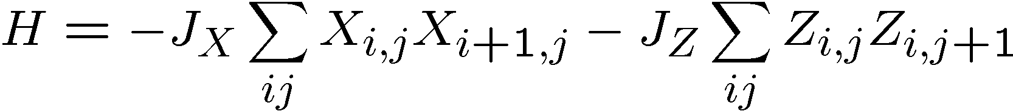
Quantum Compass Model
ZZ
ZZ
XX
XX
XX
ZZ
ZZ
XX
XX
XX
ZZ
ZZ
Ground state is a new kind of quantum error correcting code:
quantum error correcting subsystem

Slide 40






Subsystem Error Correction
Only need to protect subsystem,
not full subspaces.
encoding
subsystem
error
recovery
encoded quantum
information
recovery need not perfectly restore system, but only
preserve information encoded into subsystem.

Slide 41









Shor Stabilizer
Quantum version of parity check matrix
Stabilizer generators:
Define subspace:
Logical operators:

Slide 42
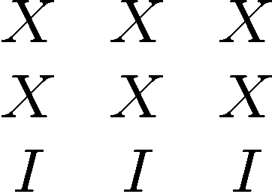
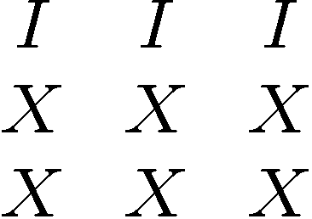
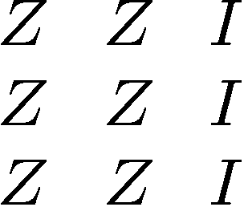
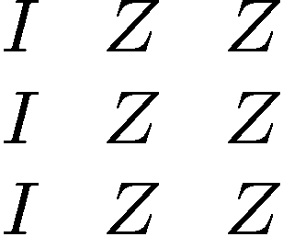

Slide 43
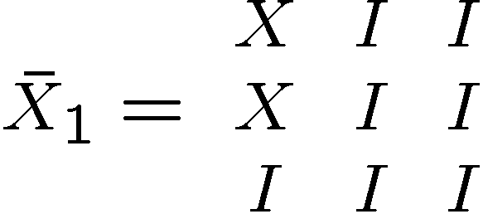
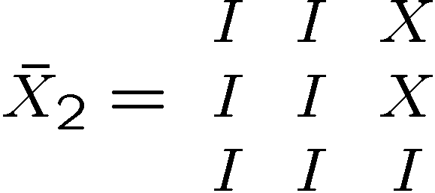
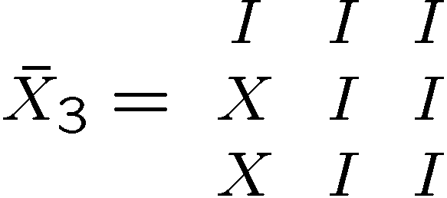
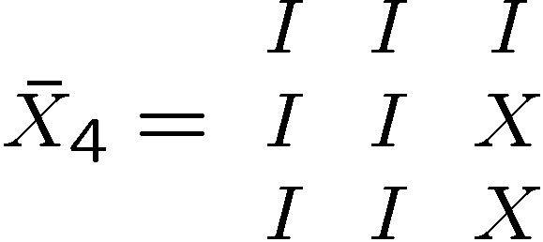
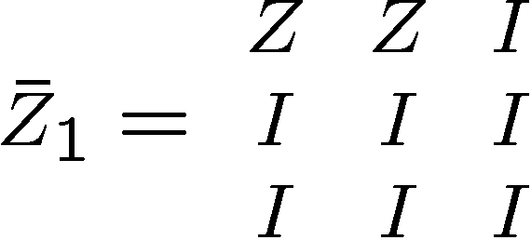
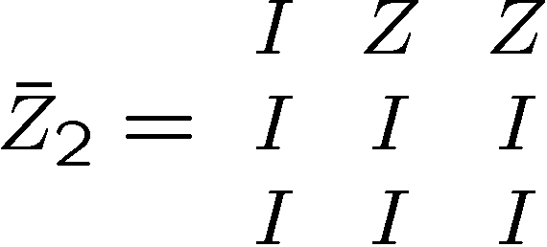
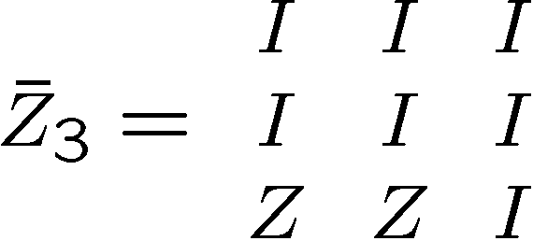
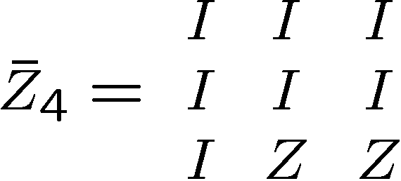
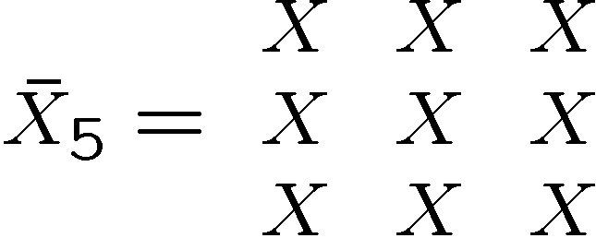
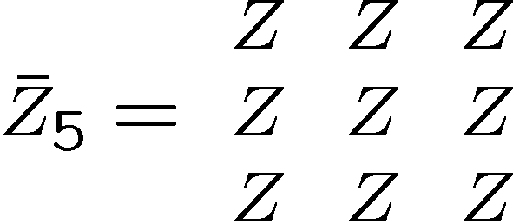
Shor Redux
Stabilizer generators:
Encodes 9-4=5 qubits of information
Logical operators:
[Bacon, Phys. Rev A, 73, 012340]

Slide 44
Shor Redux

Slide 45

Shor Redux Errors

Slide 46






Slide 47
Subsystem Code
Stabilizer generators:
plus encoded Z operators
generate all even number of Z’s per row
Measuring +1,-1 eigenvalue of
Fix modulo this group
i.e. do nothing to 5th
encoded qubit!
[Bacon, Phys. Rev A, 73, 012340, 2006]

Slide 48
Generalized Shor Subsystem Codes
Two classical codes: C₁=[n₁,k₁,d₁] and C₂=[n₂,k₂,d₂]
Quantum Shor subspace code [[n₁n₂,k₁k₂,min(d₁,d₂)]]
Number of stabilizers = (n₁-k₁)n₂+(n₂-k₂)
Quantum Shor subsystem code [[n₁n₂,k₁k₂,min(d₁,d₂)]]
Number of stabilizers= (n₁-k₁)k₂+(n₂-k₂)k₁
[Bacon, to be posted next wekk, 2006]

Slide 49
Panos Aliferis/Andrew Cross 2006

Slide 50
Quantum Compass Model
ZZ
ZZ
XX
XX
XX
ZZ
ZZ
XX
XX
XX
ZZ
ZZ
Ground state is a new kind of quantum error correcting code:
quantum error correcting subsystem

Slide 51


Problems:
[Dourier, Becca, Mila 05]
no gap in the thermodynamic limit

Slide 52

Problems, Continued
XX
XX
XX
ZZ
ZZ
ZZ
ZZ
XX
XX
XX
ZZ
ZZ
ZZ
ZZ
XX
XX
XX
Exact diagonalization 3x3, 4x4, 4x5
Even at finite size, not “self-correcting”

Slide 53


Self-Correction
energy
eigenstates

Slide 54

Toward Self-Correction
ZZ
ZZ
ZZ
XX
XX
XX
XX
n by n
square
lattice
ZZ
ZZ
ZZ
XX
XX
XX
XX
ZZ
ZZ
ZZ
XX
XX
XX
XX
ZZ
ZZ
ZZ
Exact diagonalization of 4x4 model, shows that with constant couplings, this model is self-correcting!

Slide 55

Into The Third Dimension

Slide 56


A Different Path
Potential for robust substrates for quantum information?

